Slide 1
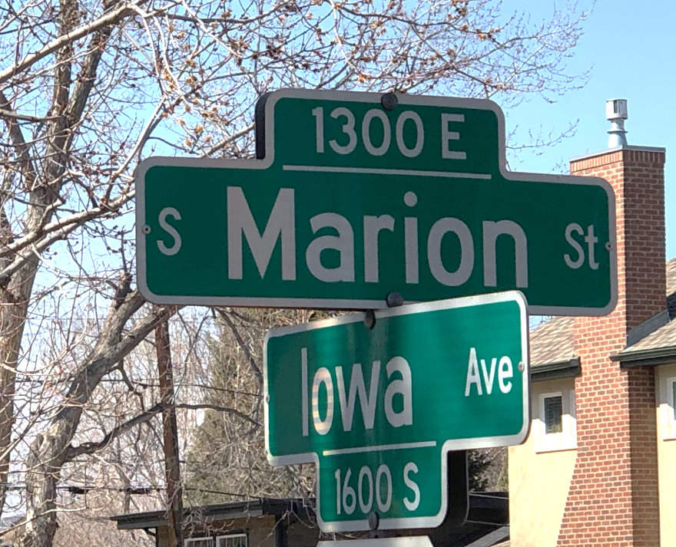
SOUTH MARION STREET NEIGHBOR CHECK
Hey Neighbors!
A few of us on the block want to help keep our neighbors stay safe and cared for during the COVID-19 spread. Please fill in the below and place it under your door mat or in your mail box by the end of tomorrow (Sunday, March 15th, 2020). We’ll take it from there!
Please check all that apply:
I am all set and don’t need anything!
I need assistance with the following:
Food Delivery Water (gallons) Hand Soap
Medicine Pickup Water (bottles) Hand Sanitizer
Paper Towels Cleaning Products
Toilet Paper Toiletries (please list: _________________)
Please list anything else you need at this time:
_______________________________________________________________
_______________________________________________________________

